Slide 1
CS2006 Operating Systems
SPRING 2023
National University of Computer and Emerging Sciences

Slide 2
Chapter 10
Virtual Memory

Slide 3
Virtual memory is a technique that allows the execution of processes that
are not completely in memory.

Slide 4
One major advantage of this scheme is that programs can be larger than physical memory
Further, virtual memory abstracts main memory into an extremely large, uniform array of storage
This technique frees programmers from the concerns of memory-storage limitations

Slide 5
Background
The memory-management algorithms outlined in Chapter 9 are necessary because of one basic requirement: the instructions being executed must be in physical memory
unfortunate, since it limits the size of a program to the size of physical memory
Dynamic linking can help to ease this restriction, but it generally requires special precautions and extra work by the programmer

Slide 6
In fact, an examination of real programs shows us that, in many cases, the entire program is not needed:
Programs often have code to handle unusual error conditions. Since these errors seldom, if ever, occur in practice, this code is almost never executed
Arrays, lists, and tables are often allocated more memory than they actually need. An array may be declared 100 by 100 elements, even though it is seldom larger than 10 by 10 elements
Certain options and features of a program may be used rarely.

Slide 7
The ability to execute a program that is only partially in memory would confer many benefits:
A program would no longer be constrained by the amount of physical memory that is available. Users would be able to write programs for an extremely large virtual address space, simplifying the programming task
Because each program could take less physical memory, more programs could be run at the same time, with a corresponding increase in CPU utilization and throughput but with no increase in response time or turnaround time
Less I/O would be needed to load or swap portions of programs into memory, so each program would run faster.

Slide 8
Virtual Memory
Virtual memory allows an extremely large virtual memory to be provided for programmers when only a smaller physical memory is available
The virtual address space of a process refers to the logical (or virtual) view of how a process is stored in memory
Typically, this view is that a process begins at a certain logical address—say, address 0—and exists in contiguous memory
Though, that in fact physical memory is organized in page frames and that the physical page frames assigned to a process may not be contiguous
It is up to the memory management unit (MMU) to map logical pages to physical page frames in memory

Slide 9
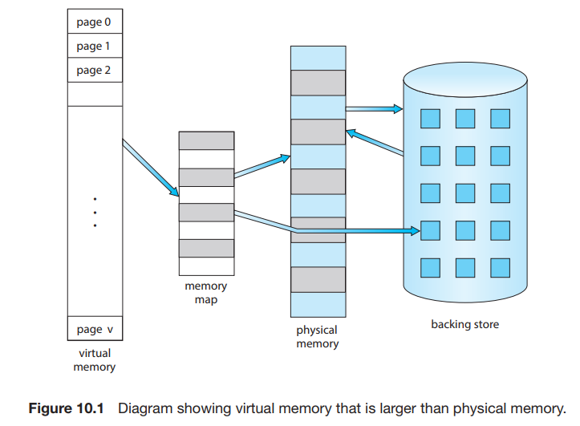

Slide 10
We allow the heap to grow upward in memory as it is used for dynamic memory allocation
Similarly, we allow for the stack to grow downward in memory through successive function calls
The large blank space (or hole) between the heap and the stack is part of the virtual address space but will require actual physical pages only if the heap or stack grows.

Slide 11
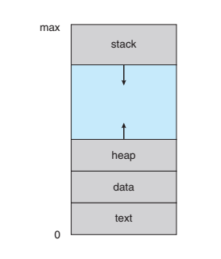

Slide 12
Virtual address spaces that include holes are known as sparse address spaces
Beneficial if we wish to dynamically link libraries (or possibly other shared objects) during program execution
Also, virtual memory allows files and memory to be shared by two or more processes through page sharing
System libraries can be shared through mapping of the shared object into a virtual address space
Similarly, processes can share memory: IPC
Pages can be shared during process creation with the fork() system call, thus speeding up process creation

Slide 13
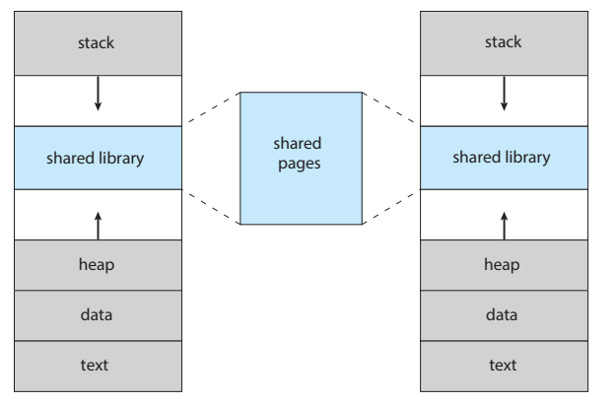

Slide 14
Demand Paging
With demand paging, pages are loaded only when they are demanded during program execution
A demand-paging system is similar to a paging system with swapping
by loading only the portions of programs that are needed, memory is used more efficiently
As a result, while a process is executing, some pages will be in memory, and some will be in secondary storage
we need some form of hardware support to distinguish between the two

Slide 15
The valid–invalid can be used for this purpose
If bit is set to “valid,” the associated page is both legal and in memory
If the bit is set to “invalid,” the page either is not valid (that is, not in the logical address space of the process) or is valid but is currently in secondary storage
A page fault occurs if the process tries to access a page that was not brought into memory.

Slide 16
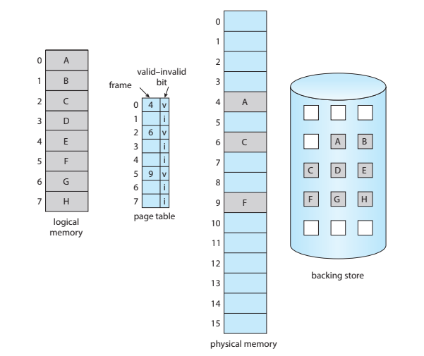

Slide 17
Handling a Page Faults
We check an internal table (usually kept with the process control block) for this process to determine whether the reference was a valid or an invalid memory access.
If the reference was invalid, we terminate the process. If it was valid but we have not yet brought in that page, we now page it in.
We find a free frame (by taking one from the free-frame list, for example)
We schedule a secondary storage operation to read the desired page into the newly allocated frame.
When the storage read is complete, we modify the internal table kept with the process and the page table to indicate that the page is now in memory
We restart the instruction that was interrupted by the trap. The process can now access the page as though it had always been in memory.

Slide 18
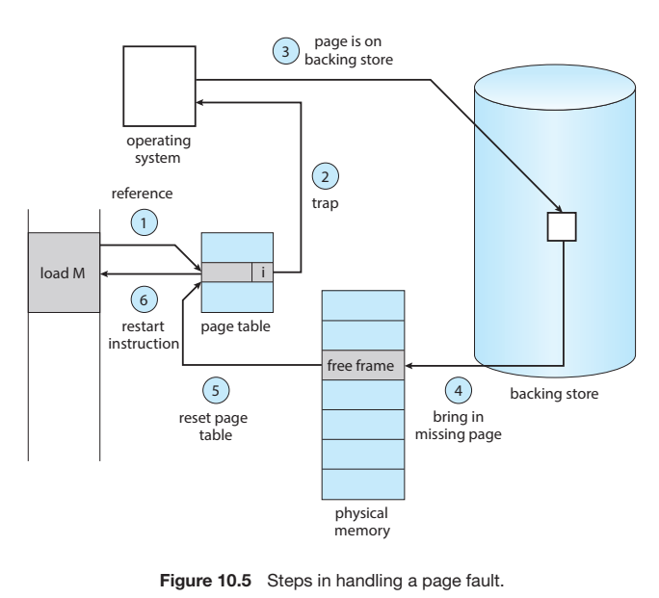

Slide 19
In the extreme case, we can start executing a process with no pages in memory.
This scheme is pure demand paging: never bring a page into memory until it is required.
Page table: This table has the ability to mark an entry invalid through a valid–invalid bit or a special value of protection bits.
Secondary memory. This memory holds those pages that are not present in main memory
It is known as the swap device, and the section of storage used for this purpose is known as swap space

Slide 20
A page fault may occur at any memory reference.
If the page fault occurs on the instruction fetch, we can restart by fetching the instruction again.
If a page fault occurs while we are fetching an operand, we must fetch and decode the instruction again and then fetch the operand

Slide 21
A page fault causes the following sequence to occur:
Trap to the operating system.
Save the registers and process state.
Determine that the interrupt was a page fault.
Check that the page reference was legal, and determine the location of the page in secondary storage.
Issue a read from the storage to a free frame:
Wait in a queue until the read request is serviced.
Wait for the device seek and/or latency time.
Begin the transfer of the page to a free frame.

Slide 22
While waiting, allocate the CPU core to some other process.
Receive an interrupt from the storage I/O subsystem (I/O completed).
Save the registers and process state for the other process (if step 6 is executed)
Determine that the interrupt was from the secondary storage device
Correct the page table and other tables to show that the desired page is now in memory.
Wait for the CPU core to be allocated to this process again
Restore the registers, process state, and new page table, and then resume the interrupted instruction

Slide 23

Free-Frame List
To resolve page faults, most operating systems maintain a free-frame list, a pool of free frames for satisfying such requests
OS allocates free frames on zero-fill-on-demand
before being allocated, erasing their previous contents

Slide 24
Performance of Demand Paging
Demand paging can significantly affect the performance of a computer system.
To see why, let’s compute the effective access time for a demand-paged memory:
Assume the memory-access time, denoted ma, is 10 nanoseconds. As long as we have no page faults, the effective access time is equal to the memory access time
if a page fault occurs, we must first read the relevant page from secondary storage and then access the desired word

Slide 25
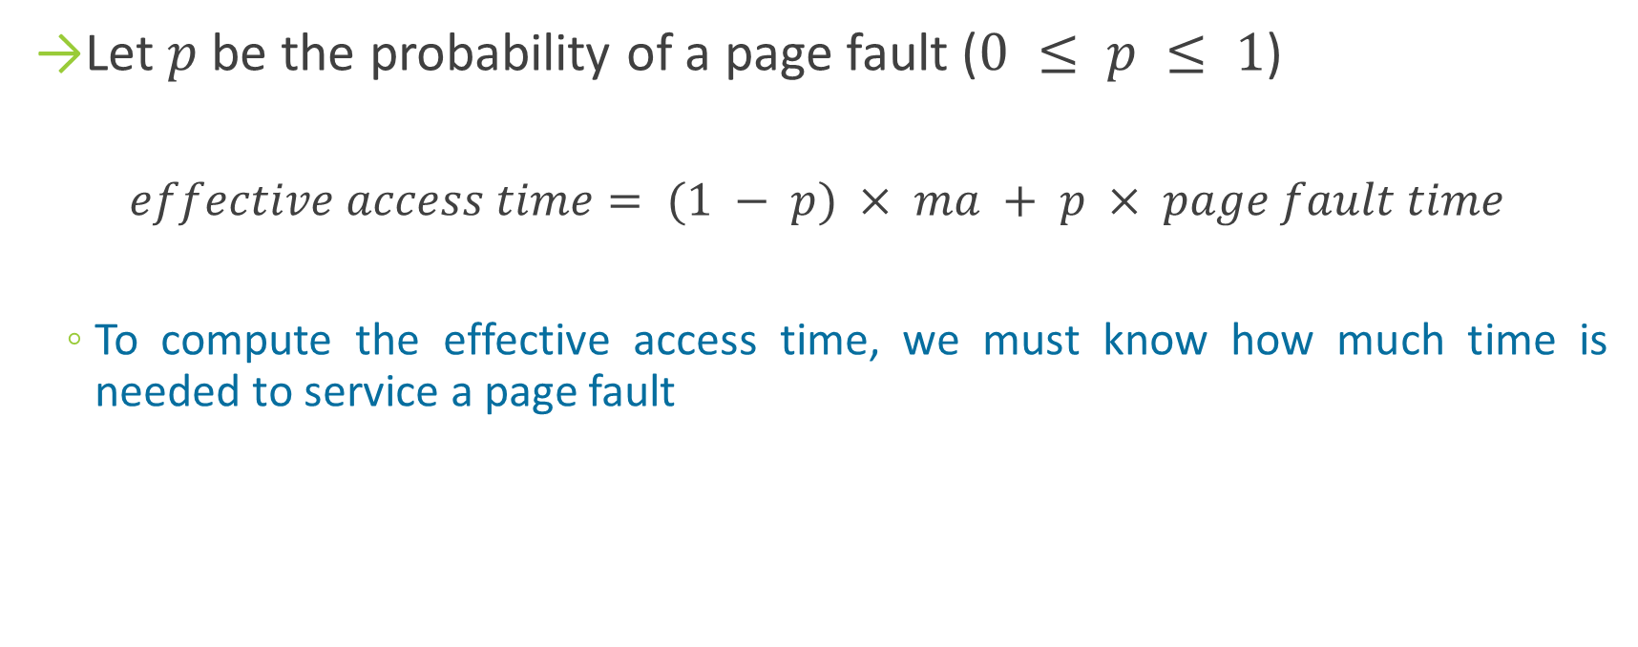
Let $p$ be the probability of a page fault ($0 ≤ p ≤ 1$)
$$effective access time= (1 − p) × ma + p × page fault time$$
To compute the effective access time, we must know how much time is needed to service a page fault

Slide 26
Let’s consider the case of HDDs being used as the paging device.
The page switch time will probably be close to 8 milliseconds.
(A typical hard disk has an average latency of 3 milliseconds, a seek of 5 milliseconds, and a transfer time of 0.05 milliseconds. Thus, the total paging time is about 8 milliseconds

Slide 27
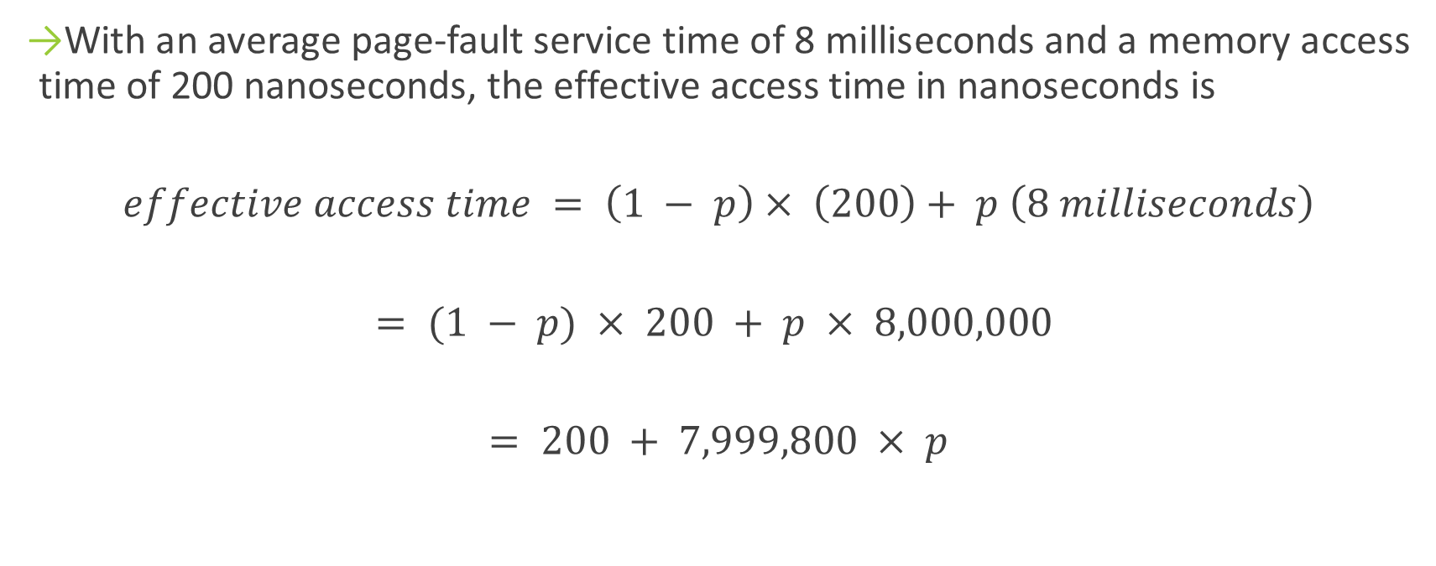
With an average page-fault service time of 8 milliseconds and a memory access time of 200 nanoseconds, the effective access time in nanoseconds is
$$effective access time = \left(1 − p\right)× \left(200\right)+ p \left(8 milliseconds\right)$$
$$= (1 − p) × 200 + p × 8,000,000$$
$$= 200 + 7,999,800 × p$$

Slide 28
the effective access time is directly proportional to the page-fault rate.
If one access out of 1,000 causes a page fault, the effective access time is 8.2 microseconds.
The computer will be slowed down by a factor of 40 because of demand paging

Slide 29
Copy-on-Write
Recall that the fork() system call creates a child process that is a duplicate of its parent
Traditionally, fork() worked by creating a copy of the parent’s address space for the child, duplicating the pages belonging to the parent
However, considering that many child processes invoke the exec() system call immediately after creation, the copying of the parent’s address space may be unnecessary
Copy-on-Write, works by allowing the parent and child processes initially to share the same pages
These shared pages are marked as copy-on-write pages, meaning that if either process writes to a shared page, a copy of the shared page is created

Slide 30
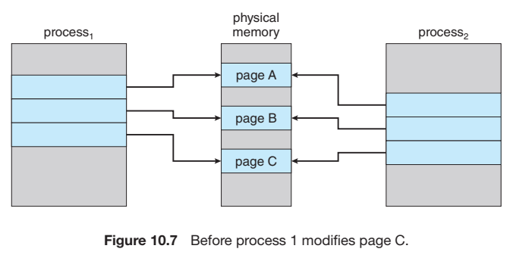
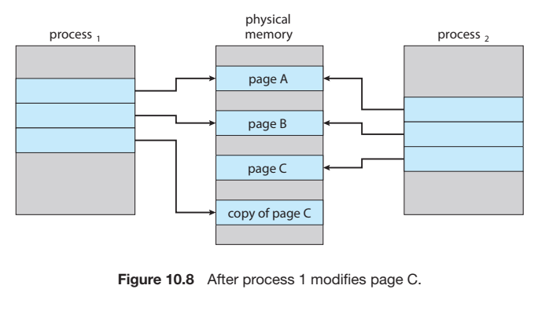

Slide 31
when the copy-on-write technique is used, only the pages that are modified by either process are copied
all unmodified pages can be shared by the parent and child processes
Also, only pages that can be modified need be marked as copy-on-write.
Pages that cannot be modified (pages containing executable code) can be shared by the parent and child.

Slide 32
Page Replacement
Memory Over-Allocation: No free frames for incoming pages, though higher CPU utilization
What if a Page Fault occurs?
The operating system could instead use standard swapping and swap out a process.
However, standard swapping is no longer used by most operating systems due to the overhead of copying entire processes between memory and swap space
Most operating systems now combine swapping pages with page replacement

Slide 33
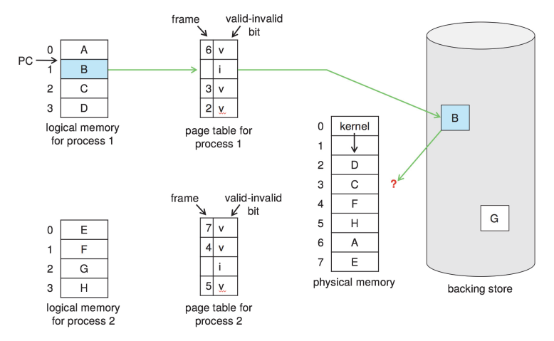

Slide 34
Basic Page Replacement
If no frame is free, we find one that is not currently being used and free it
Writing it contents to swap space and changing the page table (and all other tables) to indicate that the page is no longer in memory
Page-fault service routine is modified as follows:
Find the location of the desired page on secondary storage.
Find a free frame:
If there is a free frame, use it.
If there is no free frame, use a page-replacement algorithm to select a victim frame
Write the victim frame to secondary storage (if necessary); change the page and frame tables accordingly

Slide 35
Read the desired page into the newly freed frame; change the page and frame tables.
Continue the process from where the page fault occurred

Slide 36
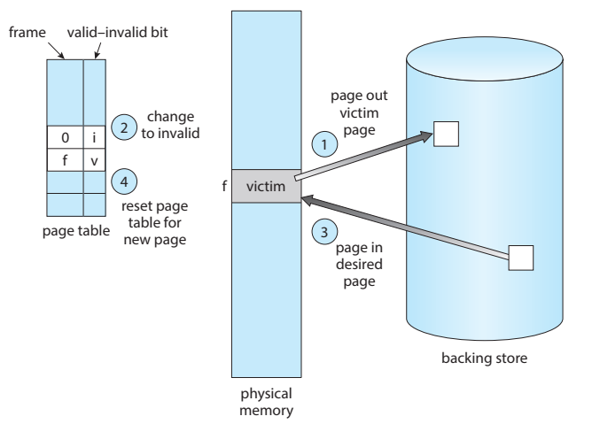

Slide 37
Notice that, if no frames are free, two page transfers (one for the page-out and one for the page-in) are required
This situation effectively doubles the page-fault service time and increases the effective access time accordingly
We can reduce this overhead by using a modify bit (or dirty bit)
SET (1) whenever the page has been modified, 0 otherwise.
When we select a page for replacement, we examine its modify bit, if the bit is SET, the page needs to be written on secondary storage when paged-out.
Otherwise, we need not write the memory page to storage
Page replacement is basic to demand paging

Slide 38
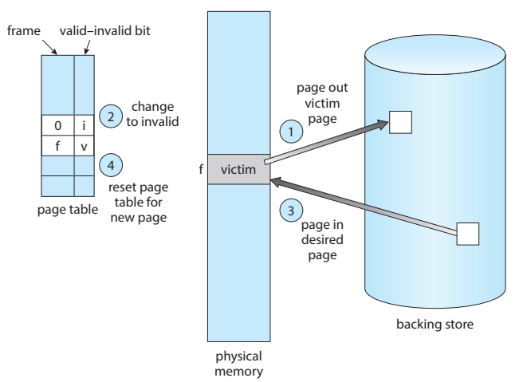

Slide 39
The two requirements of demand paging are:
frame-allocation algorithm: we must decide how many frames to allocate to each process
page-replacement algorithm: when page replacement is required, we must select the frames that are to be replaced
We evaluate an algorithm by running it on a particular string of memory references and computing the number of page faults.
The string of memory references is called a reference string

Slide 40


Reference String
For a given page size we need to consider only the page number, rather than the entire address
If we have a reference to a page p, then any references to page p that immediately follow will never cause a page fault
Page p will be in memory after the first reference
For example: if we trace a particular process, we might record the following address sequence
$$=$$

Slide 41
To determine the number of page faults for a particular reference string and page-replacement algorithm, we also need to know the number of page frames available.
Obviously, as the number of frames available increases, the number of page faults decreases
In the previous example, if we had three or more frames, we would have only three faults—one fault for the first reference to each page
with only one frame available, we would have a replacement with every reference, resulting in eleven faults

Slide 42
FIFO Page Replacement
FIFO replacement algorithm associates with each page the time when that page was brought into memory
When a page must be replaced, the oldest page is chosen
We can create a FIFO queue to hold all pages in memory
We replace the page at the head of the queue.
When a page is brought into memory, we insert it at the tail of the queue

Slide 43
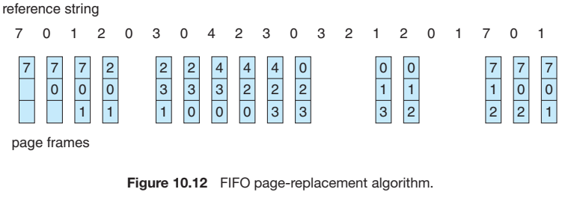

Slide 44

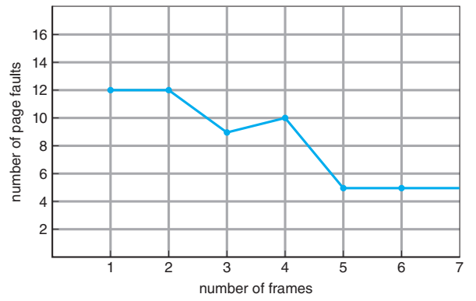

Slide 45
Notice that the number of faults for four frames (ten) is greater than the number of faults for three frames (nine)!
This most unexpected result is known as Belady’s anomaly
for some page-replacement algorithms, the page-fault rate may increase as the number of allocated frames increases.

Slide 46
Optimal Page Replacement
Replace the page that will not be used for the longest period of time
The algorithm that has the lowest page-fault rate of all algorithms and will never suffer from Belady’s anomaly.
This algorithm guarantees the lowest possible pagefault rate for a fixed number of frames

Slide 47
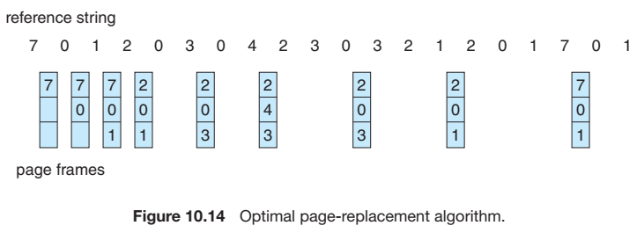

Slide 48
With only nine page faults, optimal replacement is much better than a FIFO algorithm, which results in fifteen faults
If we ignore the first three, which all algorithms must suffer, then optimal replacement is twice as good as FIFO replacement
In fact, no replacement algorithm can process this reference string in three frames with fewer than nine faults
Unfortunately, the optimal page-replacement algorithm is difficult to implement, because it requires future knowledge of the reference string

Slide 49
LRU Page Replacement
If we use the recent past as an approximation of the near future, then we can replace the page that has not been used for the longest period of time
LRU replacement associates with each page the time of that page’s last use
When a page must be replaced, LRU chooses the page that has not been used for the longest period of time
We can think of this strategy as the optimal page-replacement algorithm looking backward in time, rather than forward

Slide 50
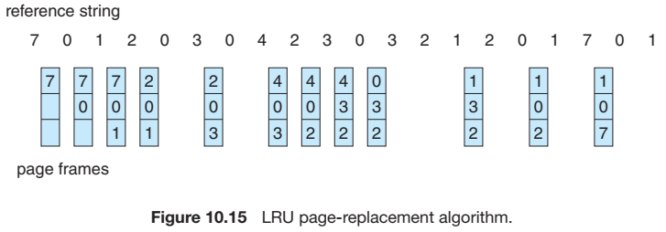

Slide 51
how to implement LRU replacement?
Counters
associate with each page-table entry a time-of-use field and add to the CPU a logical clock or counter.
The clock is incremented for every memory reference. Whenever a reference to a page is made, the contents of the clock register are copied to the time-of-use field in the page-table entry for that page
Stack
Whenever a page is referenced, it is removed from the stack and put on the top.
In this way, the most recently used page is always at the top of the stack, and the least recently used page is always at the bottom
Because entries must be removed from the middle of the stack, it is best to implement this approach by using a doubly linked list with a head pointer and a tail pointer

Slide 52
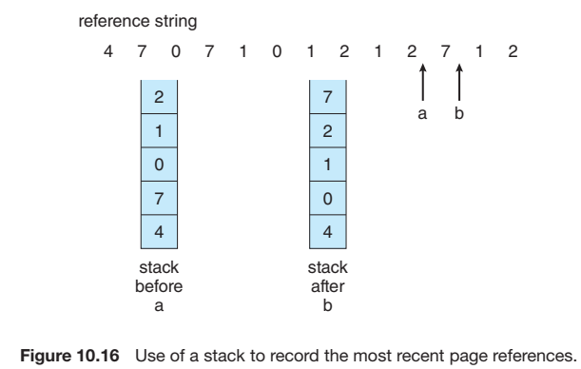

Slide 53
LRU-Approximation Page Replacement
Reference bit. The reference bit for a page is set by the hardware whenever that page is referenced
Reference bits Reference bits are associated with each entry in the page table
Initially, all bits are cleared (to 0) by the operating system.
As a process executes, the bit associated with each page referenced is set (to 1) by the hardware
After some time, we can determine which pages have been used and which have not been used by examining the reference bits, although we do not know the order of use
This information is the basis for many page-replacement algorithms that approximate LRU replacement

Slide 54
Additional-Reference-Bits Algorithm
We can gain additional ordering information by recording the reference bits at regular intervals
We can keep an 8-bit byte for each page in a table in memory
At regular intervals (say, every 100 milliseconds), operating system shifts the reference bit for each page into the high-order bit of its 8-bit byte, shifting the other bits right by 1 bit and discarding the low-order bit
These 8-bit shift registers contain the history of page use for the last eight time periods

Slide 55
E.g. 00000000, then the page has not been used for eight time periods. 11111111, the page is used at least once in each period
A page with a history register value of 11000100 has been used more recently than one with a value of 01110111
If we interpret these 8-bit bytes as unsigned integers, the page with the lowest number is the LRU page, and it can be replaced

Slide 56
Second-Chance Algorithm
The basic algorithm of second-chance replacement is a FIFO replacement algorithm
When a page has been selected for replacement, however, we inspect its reference bit.
If the value is 0, we proceed to replace this page; but if the reference bit is set to 1, we give the page a second chance and move on to select the next FIFO page
When a page gets a second chance, its reference bit is cleared, and its arrival time is reset to the current time
if a page is used often enough to keep its reference bit set, it will never be replaced

Slide 57
Second-Chance Algorithm: Implement
One way to implement the second-chance algorithm (sometimes referred to as the clock algorithm) is as a circular queue.
A pointer (that is, a hand on the clock) indicates which page is to be replaced next
When a frame is needed, the pointer advances until it finds a page with a 0 reference bit.
As it advances, it clears the reference bits
Once a victim page is found, the page is replaced, and the new page is inserted in the circular queue in that position

Slide 58
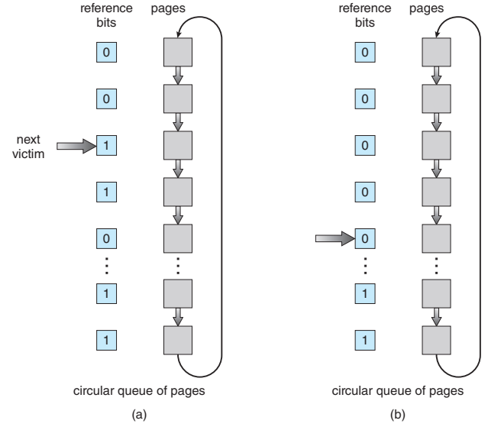

Slide 59
Enhanced Second-Chance Algorithm
Enhanced second-chance algorithm considers the reference bit and the modify bit (dirty bit).
With these two bits, we have the following four possible classes:
(0, 0) neither recently used nor modified—best page to replace
(0, 1) not recently used but modified—not quite as good, because the page will need to be written out before replacement
(1, 0) recently used but clean—probably will be used again soon
(1, 1) recently used and modified—probably will be used again soon, and the page will be need to be written out to secondary storage before it can be replaced

Slide 60
When page replacement is called for, we examine the class to which that page belongs
We replace the page belonging to the lowest nonempty class

Slide 61
Counting-Based Page Replacement
We can keep a counter of the number of references that have been made to each page and develop the following two schemes
The least frequently used (LFU) page-replacement algorithm requires that the page with the smallest count be replaced
an actively used page should have a large reference count
The most frequently used (MFU) page-replacement algorithm is based on the argument that the page with the smallest count was probably just brought in and has yet to be used

Slide 62
Allocation of Frames: Minimum # of Frames
We cannot, for example, allocate more than the total number of available frames (at max.)
One reason for allocating at least a minimum number of frames involves performance
as the number of frames allocated to each process decreases, the page-fault rate increases
we must have enough frames to hold all the different pages that any single instruction can reference

Slide 63
For example, consider a machine in which all memory-reference instructions may reference only one memory address. In this case, we need at least one frame for the instruction and one frame for the memory reference
In addition, if one-level indirect addressing is allowed (for example, a load instruction on frame 16 can refer to an address on frame 0, which is an indirect reference to frame 23), then paging requires at least three frames per process
The minimum number of frames is defined by the computer architecture.
For example, if the move instruction for a given architecture includes more than one word for some addressing modes, the instruction itself may straddle two frames
In addition, if each of its two operands may be indirect references, a total of six frames are required

Slide 64
Allocation Algorithms
The easiest way to split m frames among n processes is to give everyone an equal share, m/n frames; this scheme is called equal allocation
For instance, if there are 93 frames and 5 processes, each process will get 18 frames. The 3 leftover frames can be used as a free-frame buffer pool
Disadvantage: In a system with processes of varying sizes, assigning equal frames to each process makes little sense. Many allotted empty frames will be wasted if many frames are assigned to a small task

Slide 65
Consider a system with a 1-KB frame size.
If a small student process of 10 KB and an interactive database of 127 KB are the only two processes running in a system with 62 free frames, it does not make much sense to give each process 31 frames.
The student process does not need more than 10 frames, so the other 21 are, strictly speaking, wasted

Slide 66


Proportional Allocation
Allocate available memory to each process according to its size
Let the size of the virtual memory for process pi be si, and define
Then, if the total number of available frames is m, we allocate ai frames to process pi, where ai is approximately

Slide 67
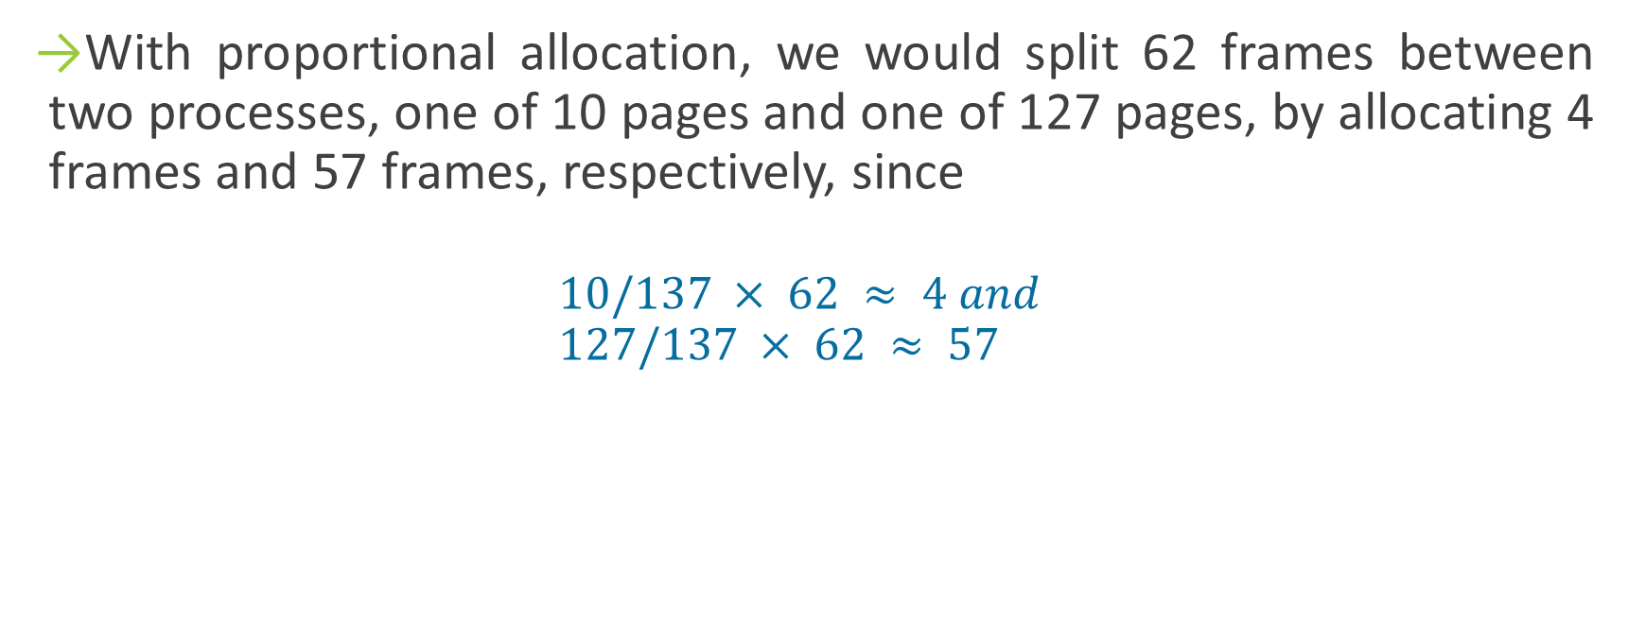
With proportional allocation, we would split 62 frames between two processes, one of 10 pages and one of 127 pages, by allocating 4 frames and 57 frames, respectively, since
$$10/137 × 62 ≈ 4 and \\ 127/137 × 62 ≈ 57$$

Slide 68
Global versus Local Allocation
With multiple processes competing for frames, we can classify page-replacement algorithms into two broad categories: global replacement and local replacement
Global replacement allows a process to select a replacement frame from the set of all frames, even if that frame is currently allocated to some other process; that is, one process can take a frame from another
Example: High-Priority Process selecting frames from low-priority processes for replacement
Local replacement requires that each process select from only its own set of allocated frames

Slide 69
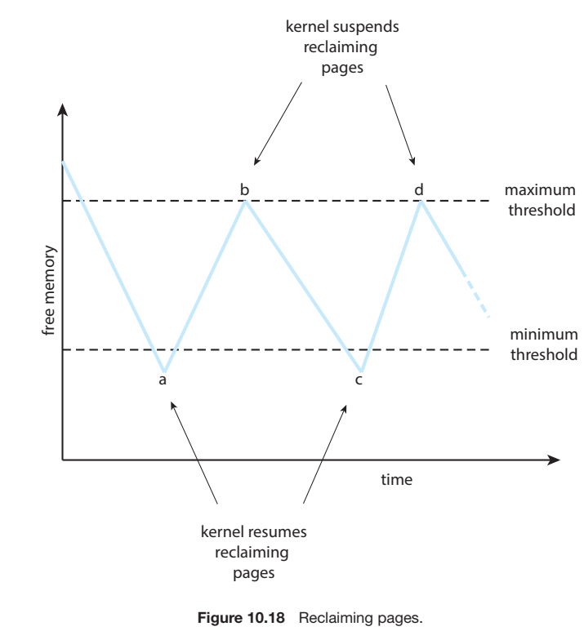
Global Allocation: Possible Implementation
Notes:
reapers use some form of LRU

Slide 70
Non-Uniform Memory Access (NUMA)
Thus far in our coverage of virtual memory, we have assumed that all main memory is created or accessed equally
On NUMA systems with multiple CPUs that is not the case
On these systems, a given CPU can access some sections of main memory faster than it can access others
Such a system is made up of multiple CPUs, each with its own local memory
a CPU can access its local memory faster than memory local to another CPU

Slide 71
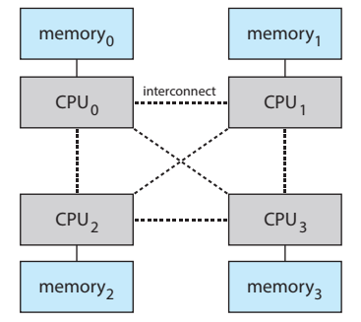

Slide 72
The goal is to have memory frames allocated “as close as possible” to the CPU on which the process is running
Thus, when a process incurs a page fault, a NUMA-aware virtual memory system will allocate that process a frame as close as possible to the CPU on which the process is running

Slide 73
Thrashing
What occurs if a process does not have “enough” frames—that is, it does not have the minimum number of frames it needs to support pages in the working set.
The process will quickly page-fault. At this point, it must replace some page
However, since all its pages are in active use, it must replace a page that will be needed again right away. Consequently, it quickly faults again, and again, and again, replacing pages that it must bring back in immediately. This high paging activity is called thrashing.

Slide 74
Thrashing
Thrashing is a phenomenon that occurs in computer operating systems when the system spends an excessive amount of time on swapping the pages due to high memory demand and low available resources
It can result in severe performance degradation, as the system spends more time swapping (paging) than executing programs

Slide 75
Cause(s) of thrashing?
Consider the following scenario, which is based on the actual behavior of early paging systems.
The operating system monitors CPU utilization. If CPU utilization is too low, we increase the degree of multiprogramming by introducing a new process to the system
A global page-replacement algorithm is used; it replaces pages without regard to the process to which they belong
Now suppose that a process enters a new phase in its execution and needs more frames. It starts faulting and taking frames away from other processes
These processes need those pages, however, and so they also fault, taking frames from other processes

Slide 76
As they queue up for the paging device, the ready queue empties. As processes wait for the paging device, CPU utilization decreases
The CPU scheduler sees the decreasing CPU utilization and increases the degree of multiprogramming as a result.
The new process tries to get started by taking frames from running processes, causing more page faults and a longer waiting queue.
As a result, CPU utilization drops even further, and the CPU scheduler tries to increase the degree of multiprogramming even more.
Thrashing has occurred, and system throughput plunges. The page-fault rate increases tremendously. As a result, the effective memory-access time increases. No work is getting done, because the processes are spending all their time paging

Slide 77
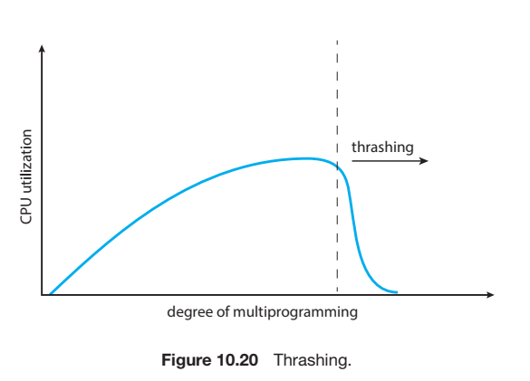

Slide 78
We can limit the effects of thrashing by using a local replacement algorithm (or priority replacement algorithm)
However, the problem is not entirely solved
To prevent thrashing, we must provide a process with as many frames as it needs. But how do we know how many frames it “needs”?
One strategy starts by looking at how many frames a process is actually using. This approach defines the locality model of process execution.

Slide 79
A locality is a set of pages that are actively used together.
As a process executes, it moves from locality to locality.
A running program is generally composed of several different localities
For example, when a function is called, it defines a new locality; When we exit the function, the process leaves this locality
Thus, we see that localities are defined by the program structure and its data structures
Suppose we allocate enough frames to a process to accommodate its current locality. It will fault for the pages in its locality until all these pages are in memory; then, it will not fault again until it changes localities

Slide 80
Working-Set Model
the working set is an approximation of the program’s locality
The idea is to examine the most recent Δ page references. The set of pages in the most recent Δ page references is the working set
The accuracy of the working set depends on the selection of Δ. If Δ is too small, it will not encompass the entire locality; if Δ is too large, it may overlap several localities

Slide 81
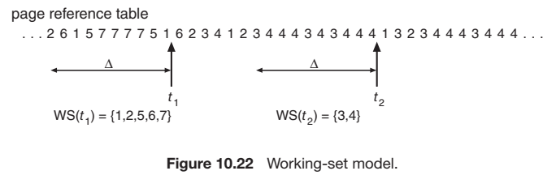

Slide 82

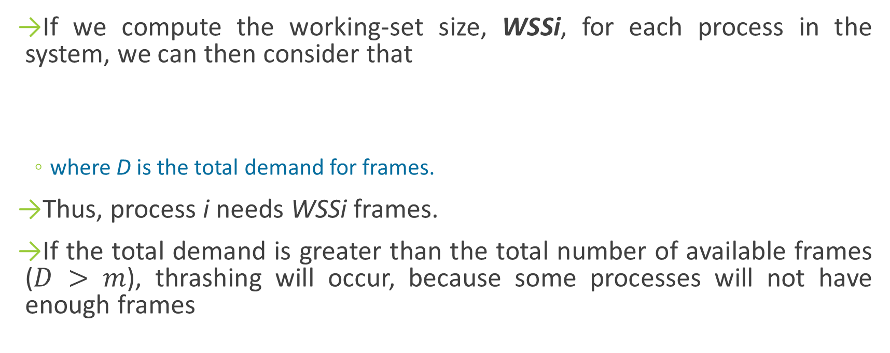
If we compute the working-set size, WSSi, for each process in the system, we can then consider that
where D is the total demand for frames.
Thus, process i needs WSSi frames.
If the total demand is greater than the total number of available frames ($D > m$), thrashing will occur, because some processes will not have enough frames

